Slide 1
AOSC200: Weather and Climate Discussion
Sections 0101, 0102
TA: Agniv Sengupta
27 February, 2019

Slide 2
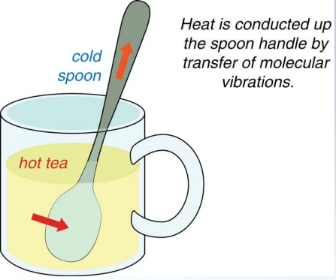
Energy Transfer: (i) Conduction
Conduction:
Requires contact, energy transferred from molecule to molecule
Air is not a good conductor
Metals are excellent conductors
Most important at earth surface

Slide 3
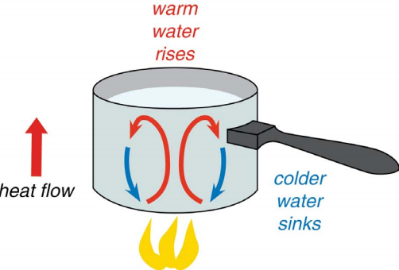
Energy Transfer: (ii) Convection

Slide 4
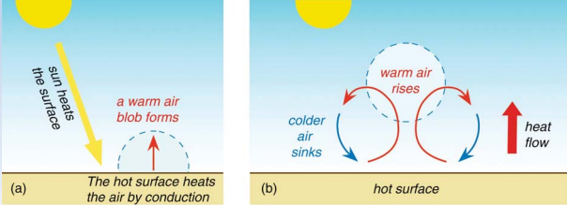
Energy Transfer: (ii) Convection
Convection:
Energy transferred by vertical movement of fluids
Air is considered a fluid
Surface energy transferred upward by convection
“Hot air rises and cool air sinks”

Slide 5
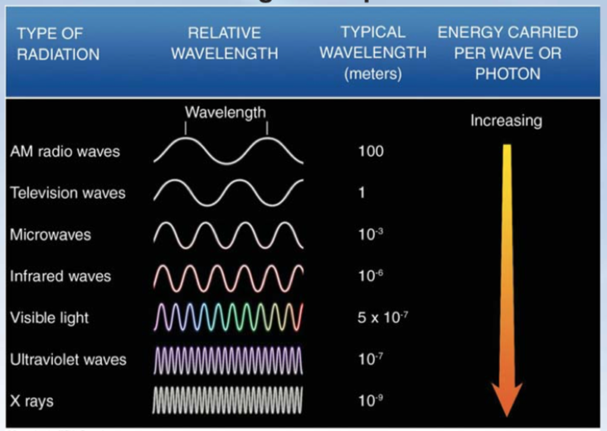
Energy Transfer: (iii) Radiation
Radiative heat:
Heating due to electromagnetic radiation (waves of energy that move through space

Slide 6
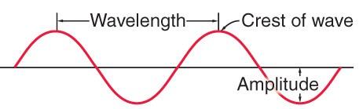
Radiation: Waves
Peak
Trough
Wavelength: length of one wave (λ , lambda)
Amplitude: height of the wave (or ½ the distance from peak to trough)
Frequency: the number of times the wave peaks in 1 second

Slide 7
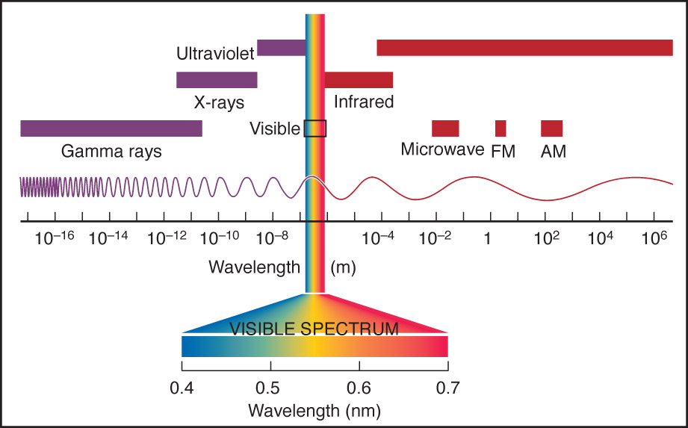
Electromagnetic Spectrum
Higher
Energy
“Shortwave”
Lower
Energy
“Longwave”

Slide 8
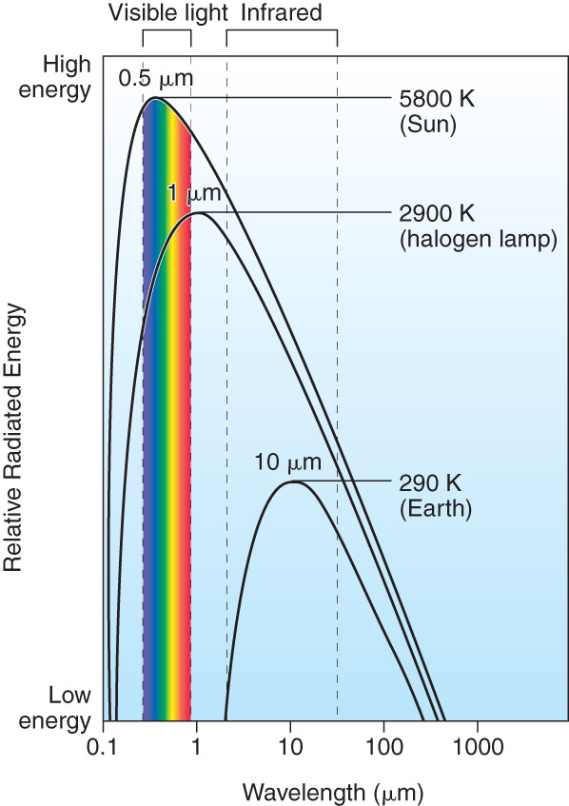
Solar Spectrum
The energy from the Sun peaks at 0.5 μm.
This happens to be in the visible portion of the spectrum.
The energy from the Earth peaks at 10 μm.
This is in the portion of the Infrared (thermal) spectrum.
This explains why we can see the Sun and why the Earth doesn’t emit visible light!

Slide 9
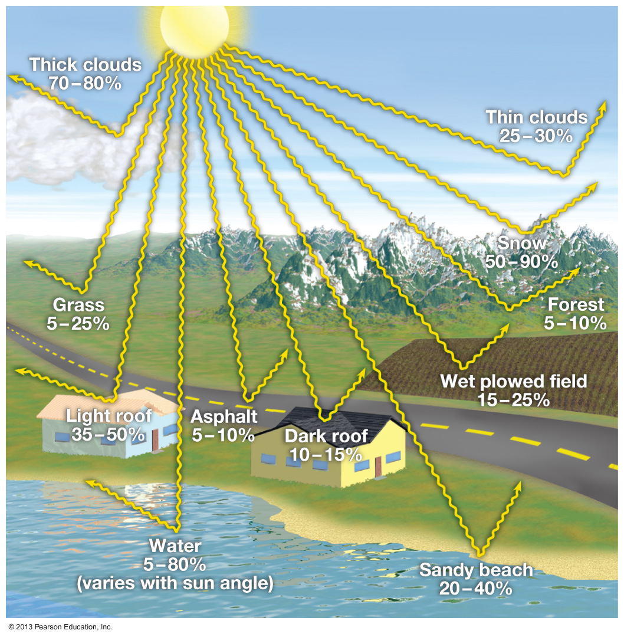
Albedo
Ratio of reflected solar radiation to the total incoming solar radiation
Higher albedo = higher reflectance
100% means everything is reflected
Snow has an albedo of 90%
Overall, the Earth’s albedo is 30%
Albedo of different surfaces
Notes:
Higher albedo surfaces can lower ambient air temp about 5C with conventional gravel surfaces

Slide 10
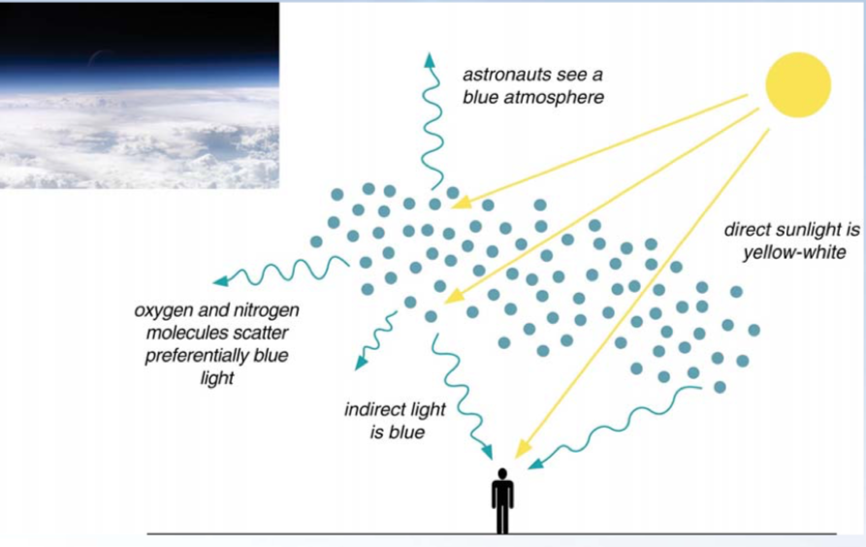
What is the color of the sky?
Oxygen and Nitrogen molecules scatter blue (preferentially) light
High noon: scattered blue light will reach us first due to the solar zenith angle.
Sunset/Sunrise: blue light is mostly removed at this point, leaving yellow-red light reaching us.
Notes:
Higher albedo surfaces can lower ambient air temp about 5C with conventional gravel surfaces

Slide 11
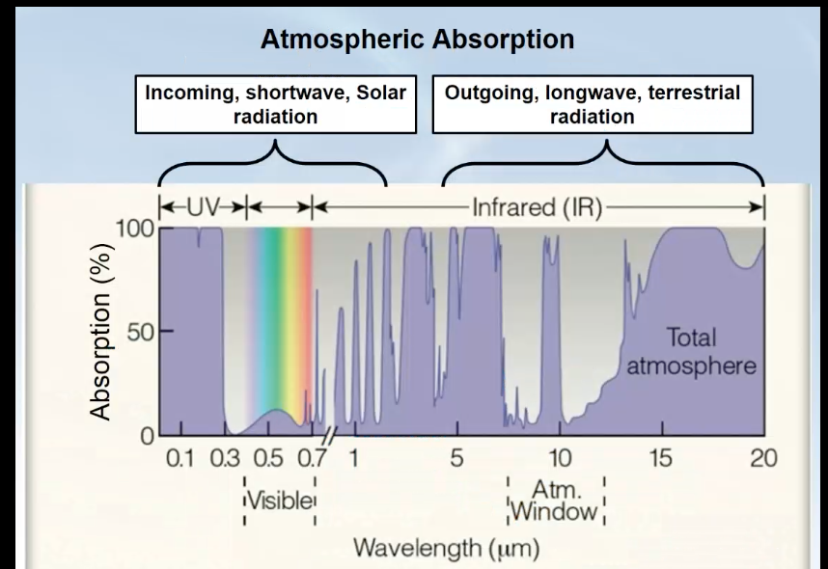
Atmospheric Absorption
Atmospheric absorption of different wavelengths by gases.
Low absorption = High transmittance → known as an atmospheric window.
Visible window is important because it helps warm our planet.
Infrared window is important because this is the energy emitted by Earth that is emitted back to space (around 7-12 micrometers)
Some IR radiation is absorbed by gases, leading to… ??

Slide 12
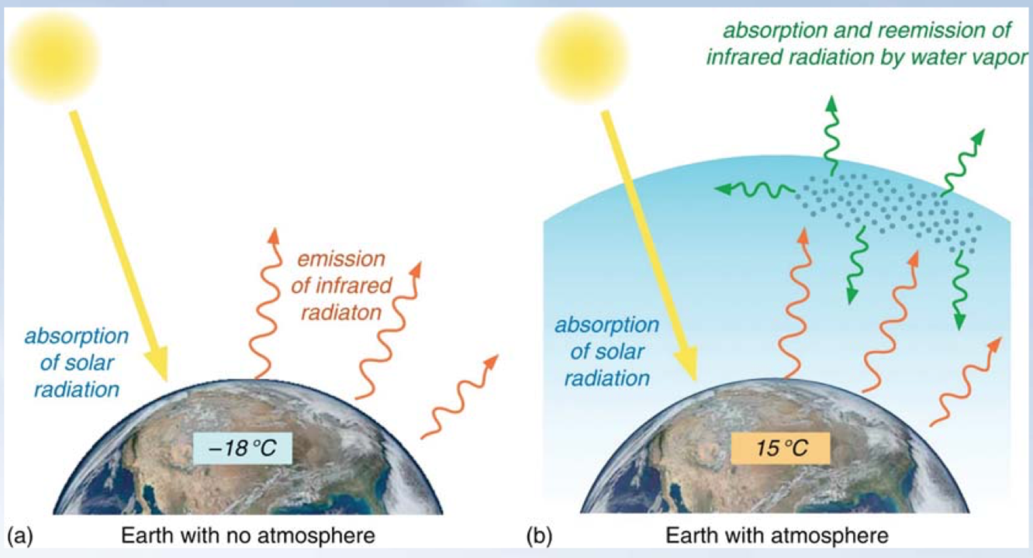
Greenhouse Effect
Earth’s atmosphere acts as a blanket - traps some of the outgoing (infrared) terrestrial radiation and reemits it to surface - commonly known as the “Greenhouse Effect”.
As the concentration of greenhouse gases increase, more thermal radiation will be absorbed and reemitted to the surface. As a result, surface temperatures will rise. This is called the Enhanced Greenhouse Effect.

Slide 13
Greenhouse Effect
Which is the most important GHG?
Which is the most important anthropogenic (human-induced) GHG?

Slide 14
Project#1: General Comments on Group Rough Drafts
I have posted comments and suggestions on every ELMS submission.
Check your sources: They should be from a government, or a university website, or a peer-reviewed scientific journal.
Make sure you and your opposing team have the same subtopics.
The Conclusion part should include evidence that you performed independent research (with 2 independent citations) and did not simply summarize previous sub-topics.

Slide 15
Which is considered plagiarism?
Copying word for word from another writer and citing/not citing them
Yes
Copying material from several writers and rearranging with citation
Yes
Paraphrasing (changing the words of the original source) with citation
No
Paraphrasing (changing the words of the original source) without citation
Yes
Failing to cite info that is common knowledge
Yes
Putting ideas into your own words with citation
No

Slide 16
Which is considered proper MLA format?
According to a climatological study by Irizarry-Ortiz et. al, there has been an increase in wet days in Florida’s dry season and increased higher temperatures in the wet season.
No
According to a climatological study by Irizarry-Ortiz et. al, there has been an increase in wet days in Florida’s dry season and increased higher temperatures in the wet season (Irizarry-Ortiz et. al, 20).
Yes
Irizarry-Ortiz, M. M. et. al. Historical Trends in Florida Temperature and Precipitation. Hydrol. Process., 2011.DOI: 10.1002/hyp.8259
Yes
Michelle Irizarry-Ortiz (Historical Trends in Florida Temperature and Precipitation) https://onlinelibrary.wiley.com/doi/10.1002/hyp.8259
No

Slide 17
Which are considered scholarly articles?
NY Times: Climate Chang Could Leave Thousands of Lakes Ice-Free
No
Atmospheric Environment: Review on urban vegetation and particle air pollution
Yes
Vox: Kids, farmers, fishermen, and cities are suing fossil fuel companies and governments. Can they win?
No
Science Daily: Carbon levels not seen in 56 million years?
No
Monthly Weather Review: A 13-year global climatology of tropical cyclone warming core structures from AIRS data
Yes
Geophysical Research Letters: Tsunami Data Assimilation Without a Dense Observation Network
Yes

Slide 18
Project#1: Important Dates
Before Presentations
2-20
½ way Peer Evaluations due (submission via ELMS)
Group Rough draft due (submission via ELMS)
Presentations
3-6 (1st Day of Debate)
All groups should be prepared; Final Group Paper containing Annotated Bibliography must be turned in BEFORE discussion.
3-13 (2nd Day of Debate)
3-27 (3rd Day of Debate)
Individual Write-ups due
Final Peer Reviews Due

Slide 19
Requirement and other reminders
At least two citations per person, with at least one originating from a government site, university site, or scholarly article
MLA format (i.e. for parenthetical citations and annotated bib)
This is not a political debate…
Try to keep the debate clean
Try to have fun
Try to avoid discussing current state
of politics
What is next week?
Presentations!
What is due next week?
Final draft!
When is it due?
When we meet for class!
Where do you submit?
On ELMS!
How many people submit?
Every team member!

Slide 20
Project#1: Final Group Paper
Every team member needs to submit the Final Group Paper– 6 sections in total. Incomplete sentences in bulleted form are not acceptable.
1st section: include Team Name, Team Members, Debate Topic, Position (PRO/CON), summary of your team members’ roles.
2nd – 6th sections: Each team member outlines their individual research and argument either in favor/opposition of the topic with at least 2 citations in MLA format per member.
2nd section: First supporting/opposing speaker (INTRODUCTION)
3rd section: Second supporting/opposing speaker (Sub-Topic A)
4th section: Third supporting/opposing speaker (Sub-Topic B)
5th section: Fourth supporting/opposing speaker (Sub-Topic C)
6th section: Fifth supporting/opposing speaker (CONCLUSION)
Work as a group to finish, each person needs a submission (everyone in the same group can submit the same document)
Include your bibliography at the end (labeling which citation belongs to which speaker).

Slide 21
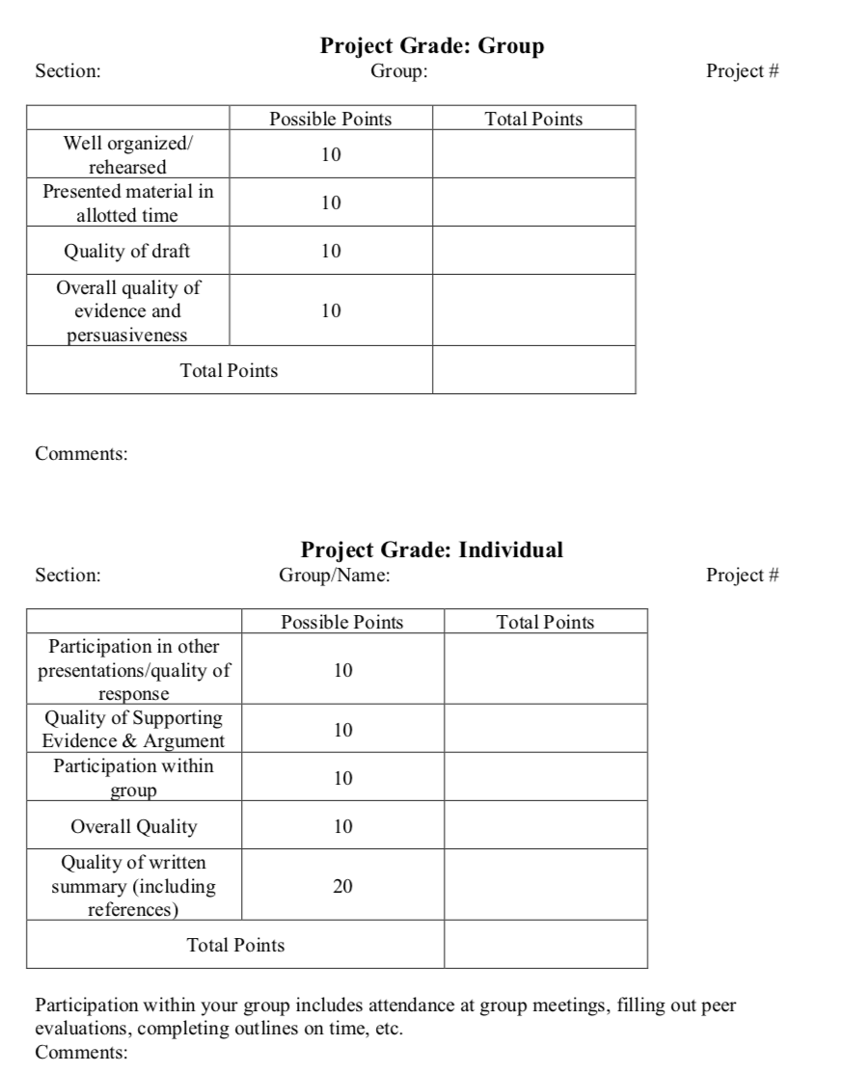
Project#1: Grading Rubric

Slide 22
Group Project#1: Oxford-style Debate
Secret Ballot of the audience (votes revealed after debate)
Introduction
1st supporting speaker (PRO) – 2.5 mins.
1st opposing speaker (CON) – 2.5 mins.
Sub-Topic A
2nd supporting speaker (PRO) – 2.5 mins.
2nd opposing speaker (CON) – 2.5 mins.
Q&A (decided on by TA through a coin flip) one team asks the other team a question – 3 minutes to respond
Sub-Topic B
3rd supporting Speaker (PRO) – 2.5 mins
3rd opposing Speaker (CON) – 2.5 mins
Q&A – other team asks a question and the team that asked the first question has 3 minutes to respond
Sub-Topic C
4th supporting speaker (PRO) – 2.5 mins.
4th opposing speaker (CON) – 2.5 mins.
Q&A – 3 minutes
Conclusion
5th supporting speaker (PRO) – 2.5 mins.
5th opposing speaker (CON) – 2.5 mins.
Open discussion – (at least 5 minutes) Audience is encouraged to ask questions
Final Secret Vote of the audience

Slide 23
Project#1: Q & A’s
Gives an opportunity for opposing teams to interact.
Gives the audience an opportunity to interact with the teams.
What you need to do:
As a group prepare 2-3 questions you want to ask the other team. This is your time to poke a flaw in their argument and challenge them. They will have 3 minutes to respond through one/two representatives.
Q&A will be held after the second, third, and fourth speaker (That’s three!)
Fates are in a coin flip, but be prepared with a number of questions which may change based off their arguments.

Slide 24
Project#1: Timing/Memorization
Sources should be cited in your debate argument.
You will have 2:30 minutes to deliver your speech/argument. I will give a 2:00 minutes warning. I will have to cut you off if you go beyond 2:40 minutes.
You need to have your speech/argument memorized. You can do it, believe me!
Practice your 2.5 minutes speech in advance.
Using notecards, pieces of paper, phones, computers, etc. of any kind will constitute automatic point deductions.

Slide 25
Project#1: Attendance
Everyone needs to attend all debates ON TIME → there will be an assignment that counts as participation points.
Audience Participation Sheet will be provided at the beginning of each debate, and collected after discussion.
Make sure to turn this document in for participation points.

Slide 26
Questions ?
Email me: agnivs@umd.edu

